Slide 1


Predicting Diabetes
Supervised by : Zainab Khudair
Prepared by : Haider Sabah

Slide 2

01
DESCRIPTION

Slide 3

DESCRIPTION :
This script is a basic implementation of a decision tree model for predicting diabetes based on various factors.
Let's break down the functionality and flow of the code:
**Data Loading**: The script starts by loading data from two Excel files: 'data’
**Model Information**: Information about the model and its dependent factors (features) is displayed.
**Input for Test Data**: The user is prompted to specify the number of rows they want to use as test data out of the available 2460 training data points.

Slide 4
DESCRIPTION :
**Data Validation**: The script checks if the user input is within the valid range (1 to 308). If not, it displays a message and exits the script.
**Data Preparation**: If the input is valid, the script splits the data into training and testing sets based on the user's input.
**Model Training**: A decision tree model is built using the training data.
**Decision Tree Visualization**: The user is asked if they want to visualize the decision tree. If they choose yes, the decision tree is displayed.
**Prediction**: The model predicts the class for the test data.
**Result Display**: The actual and predicted classes are displayed along with the corresponding input features.

Slide 5

02
Data and source

Slide 6
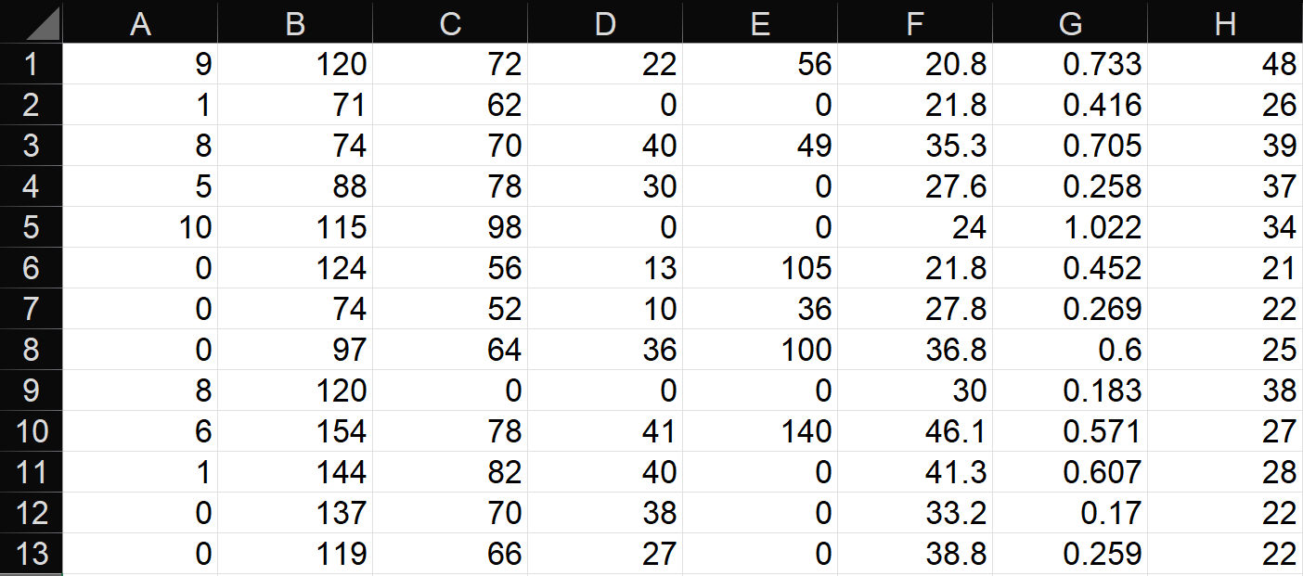
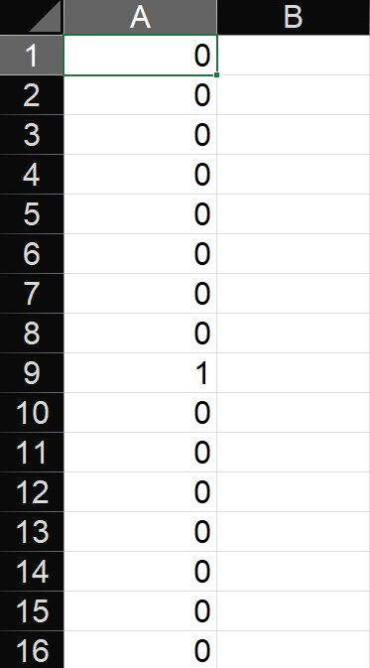

Data and source :
Pregnancies / Glucose / BloodPressure / SkinThickness / Insulin / BMI / DiabetesPedigreeFunction / Age
https://www.kaggle.com/datasets/ehababoelnaga/diabetes-dataset
kaglle

Slide 7


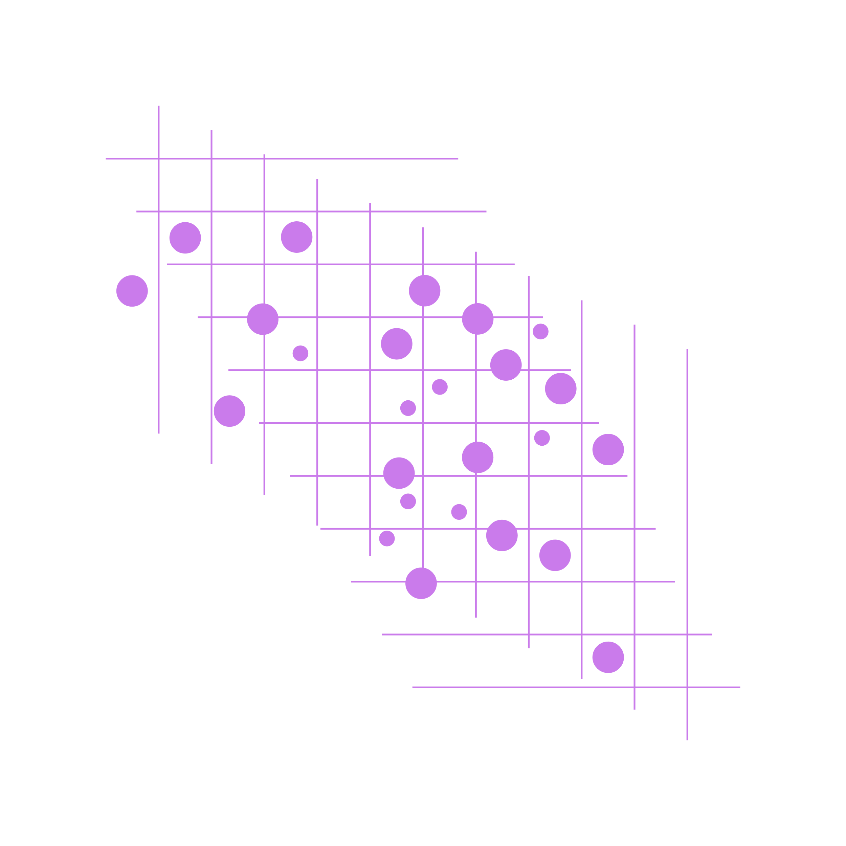
03
code

Slide 8
code :
% Clearing command window, workspace, and closing any open figures
clc;
clear;
% Loading data from Excel files ('data' and 'output')
my_data = xlsread('data');
my_output = xlsread('output');
% Displaying information about the model and its factors
disp('***************************************************');
disp('Hello, your model predicts diabetes !!');
disp('The model depends on these factors : ');
disp('Pregnancies / Glucose / Blood Pressure / Skin Thickness ');
disp('/ Insulin / BMI (Body Mass Index) / Diabetes Pedigree / Age ');
disp('***************************************************');
% Displaying the number of training data points available
disp('you have 2460 train data ! ');
disp('enter your number of rows (in that range) to make it test_data:');
train_list = input(' ---> ‘);
% Checking if the input number of rows is within the valid range
if (train_list > 2460 || train_list < 1 )
msgbox 'Number is not in range 1 : 2460 ';
clc;
clear;
close;
return; % Exiting the script if the input is out of range
else
train_data = my_data([1:train_list-1 , train_list+1:end ], :);
test_data = my_data(train_list, :);
train_target = my_output([1:train_list-1 , train_list+1:end], :);
test_target = my_output(train_list, :);
% Building a decision tree model using training data
tree_model = fitctree(train_data, train_target);
if strcmp(input('Do you want to show the decision tree? (yes/no):'), 'yes')
view(tree_model, 'Mode', 'graph');
predict_class = predict(tree_model, test_data);
disp('1 // Means He Have Diabetes , 0 // He Have not !!');
disp('Actual Class : '); disp(test_target);
disp('Pregnancies / Glucose / Blood Pressure / Skin Thickness/ Insulin / BMI / (Body Mass Index) / Diabetes Pedigree / Age ‘);
disp(test_data);
if (predict_class == 1)
disp('Predicted Class : '); disp(predic_class); disp(' *** The Patient Has Diabetes ***' );
else
disp('Predicted Class : '); disp(predict_class); disp('*** The Patient Does Not Have Diabetes ***' );
end
end

Slide 9


Thank you

